Slide 1
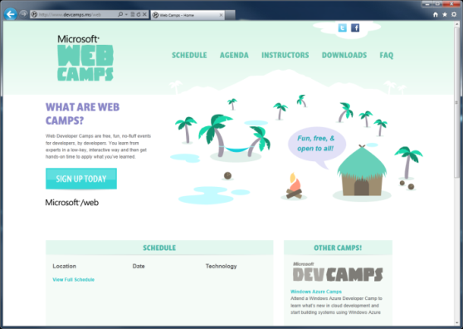

WebCamps Online
Twitter: Follow @webcamps Hashtag #webcamps
SPEAKER NAME/HANDLE HERE
Website: http://www.devcamps.ms/web
What are web camps?
Web Developer Camps are free, fun, no-fluff events for developers, by developers. You learn from experts in a low-key, interactive way and then get hands-on time to apply what you’ve learned.

Slide 2
Integrating Your Site with Internet Explorer 9 (& 10!)
Name
Title
Microsoft Corporation

Slide 3
Agenda
Windows and the Web
Pinned Sites
Interoperable
IE9 & HTML5
Building a Fast Web Experience
Getting Ready for Internet Explorer 10

Slide 4
Windows & the Web

Slide 5
Windows & the Web
57% of all time spent on a PC is in a browser

Slide 6
Web browsing is Core to the Windows Experience
The browser is the stage, not the play

Slide 7

IE Puts the Focus Back on Your Site

Slide 8
Pinned Sites

Slide 9
Behind the Scenes
Pinned site execution details:
Creates an isolated instance of Internet Explorer
Generates an AppID for a specific URL
BHOs and other toolbars are not enabled
Share the same real estate as Windows applications

Slide 10
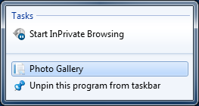
Pinning a Site Using Meta
<head>
<title>@Page.Title</title>
<meta name="application-name" content="Photo Gallery" />
<meta name="msapplication-tooltip" content="Photo Gallery" />
<meta name="msapplication-window" content="width=1024;height=768" />
<meta name="msapplication-starturl" content="http://localhost:42179/" />
</head>

Slide 11
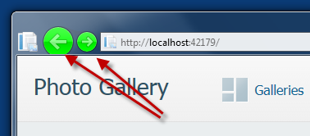
Pinning a Site Using Meta
<head>
<title>@Page.Title</title>
<meta name="application-name" content="Photo Gallery" />
<meta name="msapplication-tooltip" content="Photo Gallery" />
<meta name="msapplication-window" content="width=1024;height=768" />
<meta name="msapplication-starturl" content="http://localhost:42179/" />
<meta name="msapplication-navbutton-color" content="#00FF00" />
</head>

Slide 12
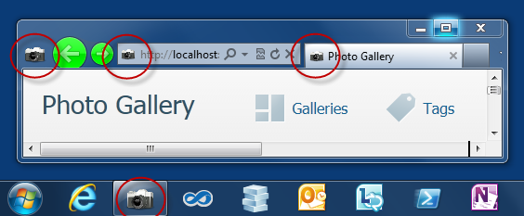
Customizing the Icon
<head>
<title>@Page.Title</title>
<meta name="application-name" content="Photo Gallery" />
<meta name="msapplication-tooltip" content="Photo Gallery" />
<meta name="msapplication-window" content="width=1024;height=768" />
<meta name="msapplication-starturl" content="http://localhost:42179/" />
<meta name="msapplication-navbutton-color" content="#00FF00" />
<link rel="shortcut icon" href="~/slr_camera.ico"/>
</head>

Slide 13
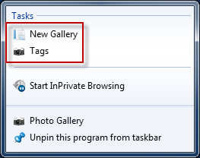
Adding a Jump List
<head>
<title>@Page.Title</title>
…
<link rel="shortcut icon" href="~/slr_camera.ico"/>
<meta name="msapplication-task" content="name=New Gallery;
action-uri=http://localhost:42179/New;
icon-uri=favicon.ico"/>
<meta name="msapplication-task"
content="name=Tags;
action-uri=http://localhost:42179/Tag;
icon-uri=slr_camera.ico"/>
</head>

Slide 14
Pinning a Site
demo

Slide 15
Interoperable

Slide 16
Working with Standards Bodies
Member of many W3C Working Groups

Slide 17
The HTML Working Group
40 W3C Member Organizations
411 group participants
280 invited experts
9 mailing lists
around 4000 emails on public-html

Slide 18
Keep Up with Standards Adoption
Internet Explorer Testing Center http://samples.msdn.microsoft.com/ietestcenter

Slide 19
IE9 & HTML5

Slide 20
HTML 5 At a Glance
Commonly used to refer to modern open web standards like HTML5, CSS3, and more
Adds new rich media and graphics support (canvas, video, audio, inline SVG…)
Standardizes behavior for browser vendors, enabling same markup

Slide 21
Canvas
A block element that allows developers to draw 2d graphics using JavaScript
Methods for drawing include: paths, boxes, circles, text and rasterized images
<canvas id="myCanvas" width="200" height="200">
Your browser doesn’t support Canvas, sorry.
</canvas>
<script type="text/javascript">
var example = document.getElementById("myCanvas");
var context = example.getContext("2d");
context.fillStyle = "rgb(255,0,0)";
context.fillRect(30, 30, 50, 50);
</script>

Slide 22
Scalable Vector Graphics (SVG)
Create and draw 2D vector graphics using XML
Vector images are composed of shapes instead of pixels
Based on the SVG 1.1 2nd Edition Full specification
Full DOM access to SVG elements
Document structure, scripting, styling, paths, shapes, colors, transforms, gradients, patterns, masking, clipping, markers, linking and views

Slide 23

SVG Code Example
A block element that allows developers to draw 2d graphics using JavaScript
Methods for drawing include: paths, boxes, circles, text and rasterized images
<svg width="400" height="200" xmlns="http://www.w3.org/2000/svg">
<rect fill="red" x="20" y="20" width="100" height="75" />
<rect fill="blue" x="50" y="50" width="100" height="75" />
</svg>

Slide 24
HTML 5 <video>
Support for the HTML5 <video> element
Industry-standard MPEG-4/H.264 video
Video can be composited with anything else on the page
HTML content, images, SVG graphics
Hardware accelerated, GPU-based decoding

Slide 25
HTML 5 <video> Attributes
src – specifies the location to pull the source file
autoplay – if present starts playing as soon as it’s ready
controls – if present displays controls
preload – if present loads source at page load
loop – if present loops back to the beginning of the video
height & width – specifies the height & width of the player
<video src="video.mp4" id="videoTag" width="640px" height="360px">
<!-- Only shown when browser doesn’t support video -->
<!-- You Could Embed Flash or Silverlight Video Here -->
</video>

Slide 26
HTML 5 <audio>
Industry-standard MP3 and AAC audio
Fully scriptable via the DOM
Attributes
src – specifies the location to pull the source file
autoplay – if present starts playing as soon as it’s ready
controls – if present displays controls
preload – if present loads source at page load
<audio src="audio.mp3" id="audioTag" autoplay controls>
<!-- Only shown when browser doesn’t support audio -->
<!-- You could embed Flash or Silverlight audio here -->
</audio>

Slide 27
Fonts & @font-face
Web Open Font Format allows you to package and deliver fonts as needed, per site
Designed for web use with the @font-face declaration
<style type="text/css">
@font-face {
font-family:MyFontName;
src: url('FontFile.woff');
}
</style>
<div style="font: 24pt MyFontName, sans-serif;">
This will render using MyFontName in FontFile.woff
</div>

Slide 28
CSS3 Media Queries
Selectively style page based on properties of the media
<style type="text/css">
@font-face {
font-family:MyFontName;
src: url('FontFile.woff');
}
</style>
<div style="font: 24pt MyFontName, sans-serif;">
This will render using MyFontName in FontFile.woff
</div>

Slide 29
CSS3 Colors
Alpha color with rgba() and hsla() color functions
Transparency control with the opacity property
Can be used with any property that takes the color property
div.top {
background-color: rgba(0, 0, 0, 0.5);
color: azure;
}
div.bottom {
background-color: hlsa(0, 0%, 0%, 0.5);
color: cornsilk;
}

Slide 30
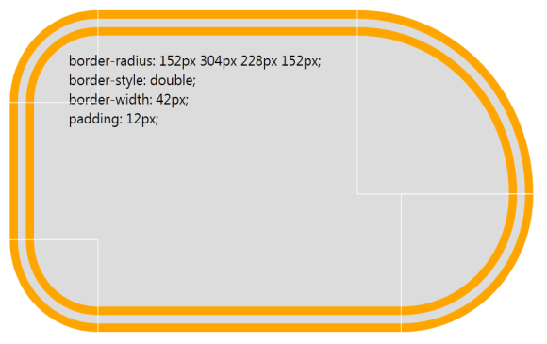
CSS3 Backgrounds & Borders
Round corners with the border-radius property
Multiple background images per element
Box-shadow property on block elements
div {
border-radius: 152px 304px 228px 152px;
border-style: double;
border-width: 42px;
padding: 12px;
}

Slide 31
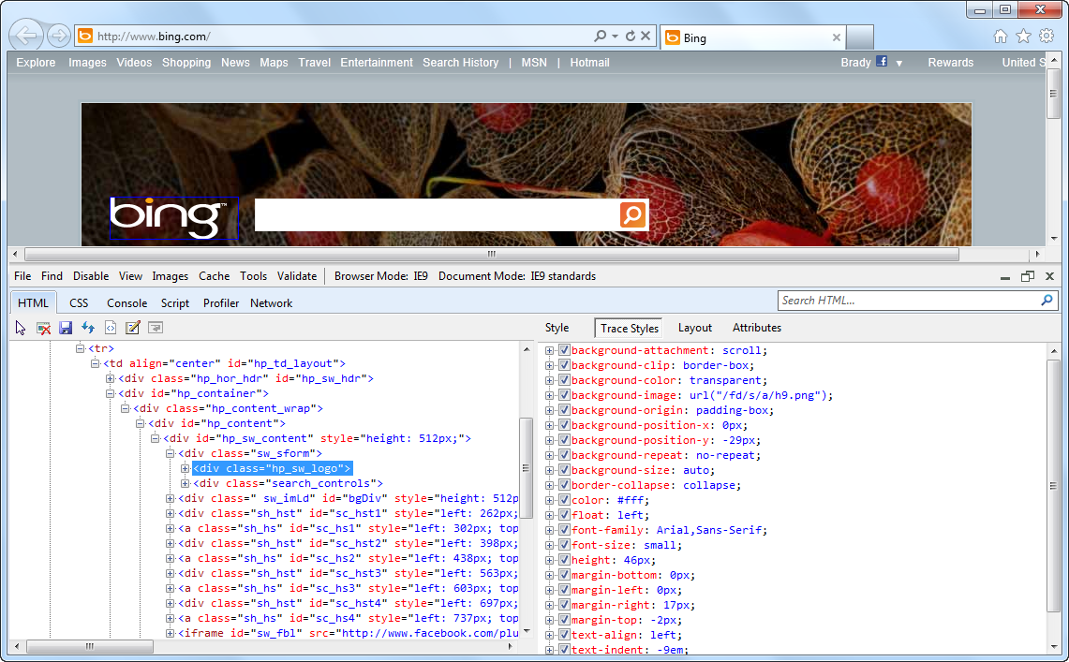
1 Key Press (F12) Developer Tools

Slide 32
Building a Fast Web Experience

Slide 33
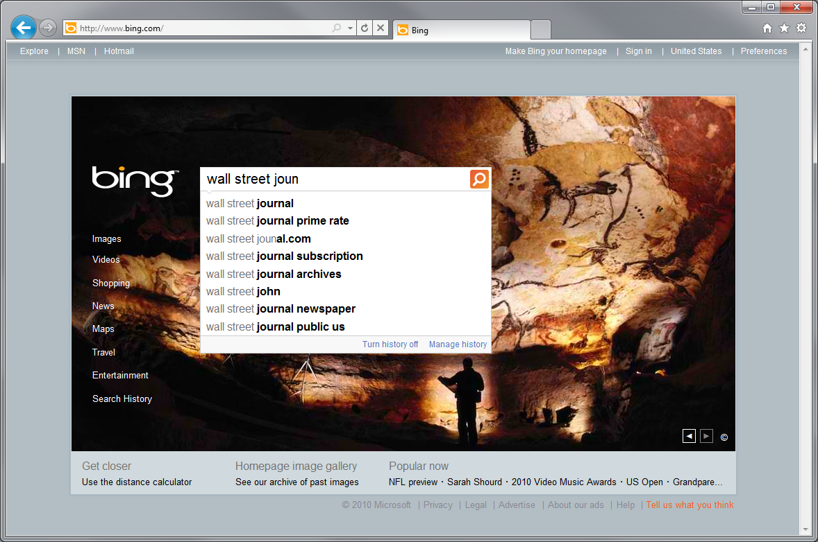
Example Scenario - The Wall Street Journal

Slide 34

Some Markup Has Been Retrieved

Slide 35
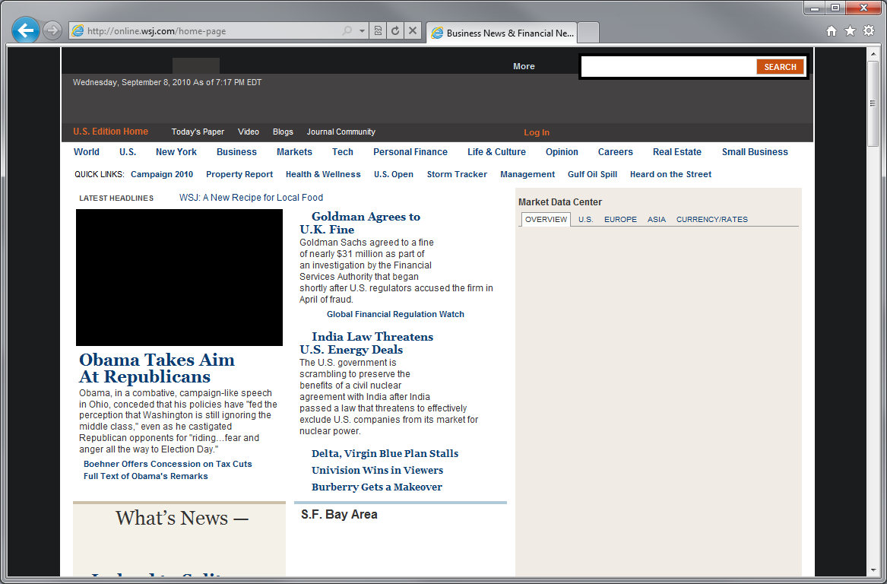
Content Starts To Render

Slide 36
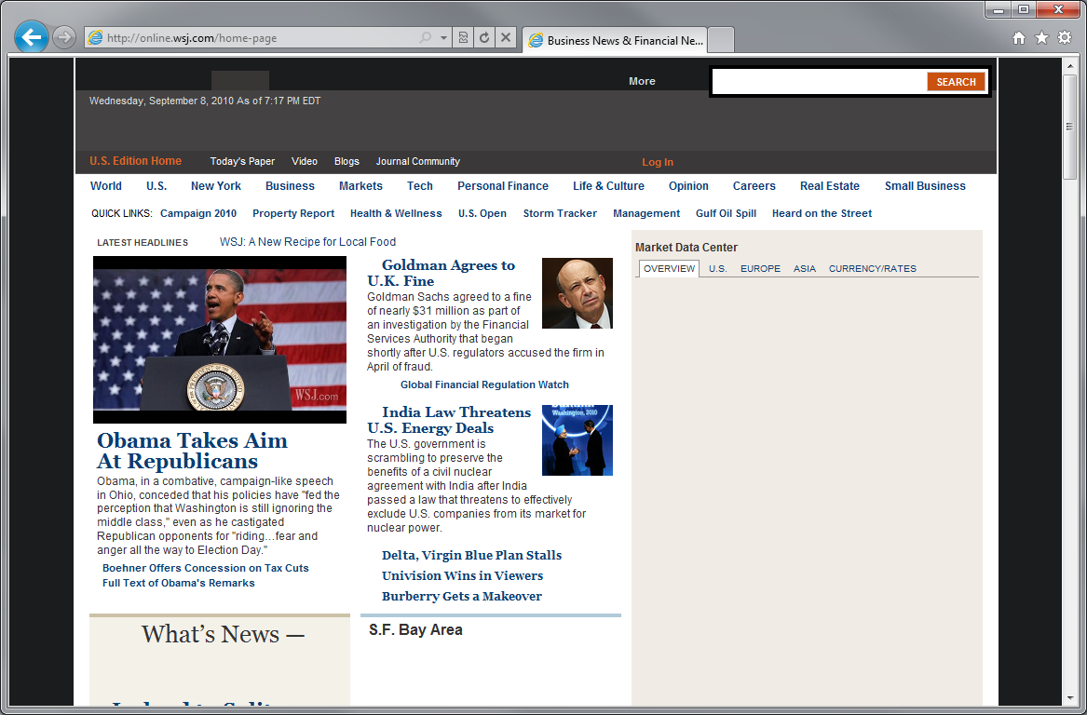
Some Images Start To Appear

Slide 37

Mast Head Appears

Slide 38
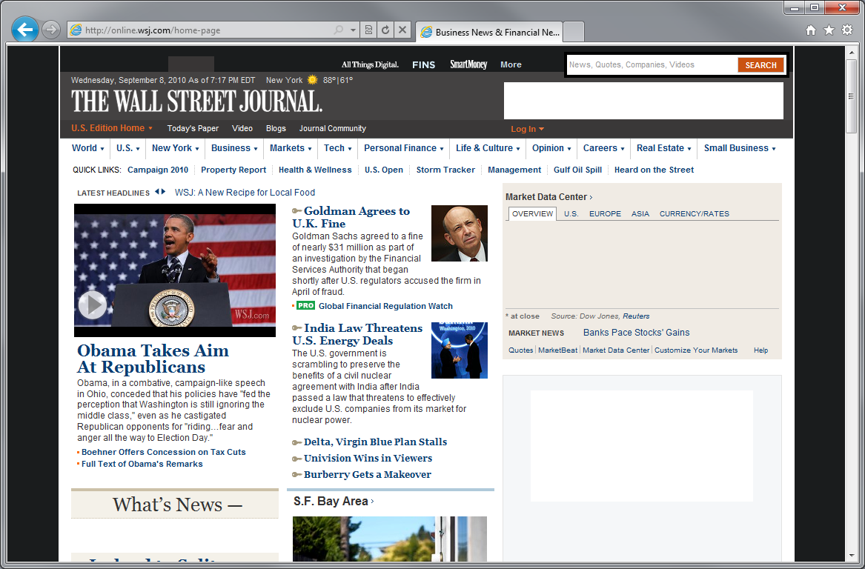
Right Column Starts To Render

Slide 39

Personalized Content Starts To Appear

Slide 40

Advertisements Load

Slide 41
Done!

Slide 42

Browser Subsystems
Rendering
Layout
Block Building
Formatting
DOM
Marshalling
JavaScript
Collections
CSS
HTML
Networking

Slide 43
Picking Five Popular News Sites
Wall Street Journal
Chicago Tribune
USA Today
New York Times
Washington Post
CNN News
Seattle Times
MSN News
Financial Times
Boston Globe
News Site #1
News Site #2
News Site #3
News Site #4
News Site #5

Slide 44
Five Popular News Sites
 | Total Size | Number Elements | CSS Rules | Image Files | Script Files | Script Lines | Script Libs
News Site #1 | 3280kb | 8662 | 1293 | 137 | 21 | 14,216
News Site #2 | 961kb | 820 | 2964 | 44 | 16 | 3,812
News Site #3 | 300kb | 1187 | 1366 | 26 | 4 | 9,481
News Site #4 | 1462kb | 4257 | 893 | 76 | 21 | 11,988
News Site #5 | 2981kb | 3578 | 1917 | 88 | 19 | 20,722
JQuery
YUI
Prototype
MooTools
Scriptaculous
Other (JS Lib)

Slide 45
Five Popular News Sites
Variation in Total Size
 | Total Size | Number Elements | CSS Rules | Image Files | Script Files | Script Lines | Script Libs
News Site #1 | 3280kb | 8662 | 1293 | 137 | 21 | 14,216
News Site #2 | 961kb | 820 | 2964 | 44 | 16 | 3,812
News Site #3 | 300kb | 1187 | 1366 | 26 | 4 | 9,481
News Site #4 | 1462kb | 4257 | 893 | 76 | 21 | 11,988
News Site #5 | 2981kb | 3578 | 1917 | 88 | 19 | 20,722
JQuery
YUI
Prototype
MooTools
Scriptaculous
Other (JS Lib)

Slide 46
Five Popular News Sites
Number Elements to Number of CSS Rules
 | Total Size | Number Elements | CSS Rules | Image Files | Script Files | Script Lines | Script Libs
News Site #1 | 3280kb | 8662 | 1293 | 137 | 21 | 14,216
News Site #2 | 961kb | 820 | 2964 | 44 | 16 | 3,812
News Site #3 | 300kb | 1187 | 1366 | 26 | 4 | 9,481
News Site #4 | 1462kb | 4257 | 893 | 76 | 21 | 11,988
News Site #5 | 2981kb | 3578 | 1917 | 88 | 19 | 20,722
JQuery
YUI
Prototype
MooTools
Scriptaculous
Other (JS Lib)

Slide 47
Five Popular News Sites
Number of Images
 | Total Size | Number Elements | CSS Rules | Image Files | Script Files | Script Lines | Script Libs
News Site #1 | 3280kb | 8662 | 1293 | 137 | 21 | 14,216
News Site #2 | 961kb | 820 | 2964 | 44 | 16 | 3,812
News Site #3 | 300kb | 1187 | 1366 | 26 | 4 | 9,481
News Site #4 | 1462kb | 4257 | 893 | 76 | 21 | 11,988
News Site #5 | 2981kb | 3578 | 1917 | 88 | 19 | 20,722
JQuery
YUI
Prototype
MooTools
Scriptaculous
Other (JS Lib)

Slide 48
Five Popular News Sites
Amount of JavaScript
 | Total Size | Number Elements | CSS Rules | Image Files | Script Files | Script Lines | Script Libs
News Site #1 | 3280kb | 8662 | 1293 | 137 | 21 | 14,216
News Site #2 | 961kb | 820 | 2964 | 44 | 16 | 3,812
News Site #3 | 300kb | 1187 | 1366 | 26 | 4 | 9,481
News Site #4 | 1462kb | 4257 | 893 | 76 | 21 | 11,988
News Site #5 | 2981kb | 3578 | 1917 | 88 | 19 | 20,722
JQuery
YUI
Prototype
MooTools
Scriptaculous
Other (JS Lib)

Slide 49
Five Popular News Sites
Amount of JavaScript
 | Total Size | Number Elements | CSS Rules | Image Files | Script Files | Script Lines | Script Libs
News Site #1 | 3280kb | 8662 | 1293 | 137 | 21 | 14,216
News Site #2 | 961kb | 820 | 2964 | 44 | 16 | 3,812
News Site #3 | 300kb | 1187 | 1366 | 26 | 4 | 9,481
News Site #4 | 1462kb | 4257 | 893 | 76 | 21 | 11,988
News Site #5 | 2981kb | 3578 | 1917 | 88 | 19 | 20,722
JQuery
YUI
Prototype
MooTools
Scriptaculous
Other (JS Lib)

Slide 50
Which Sites Loads the Fastest?
 | Total Size | Number Elements | CSS Rules | Image Files | Script Files | Script Lines | Script Libs
News Site #1 | 3280kb | 8662 | 1293 | 137 | 21 | 14,216
News Site #2 | 961kb | 820 | 2964 | 44 | 16 | 3,812
News Site #3 | 300kb | 1187 | 1366 | 26 | 4 | 9,481
News Site #4 | 1462kb | 4257 | 893 | 76 | 21 | 11,988
News Site #5 | 2981kb | 3578 | 1917 | 88 | 19 | 20,722
JQuery
YUI
Prototype
MooTools
Scriptaculous
Other (JS Lib)

Slide 51
Which Sites Loads the Slowest?
 | Total Size | Number Elements | CSS Rules | Image Files | Script Files | Script Lines | Script Libs
News Site #1 | 3280kb | 8662 | 1293 | 137 | 21 | 14,216
News Site #2 | 961kb | 820 | 2964 | 44 | 16 | 3,812
News Site #3 | 300kb | 1187 | 1366 | 26 | 4 | 9,481
News Site #4 | 1462kb | 4257 | 893 | 76 | 21 | 11,988
News Site #5 | 2981kb | 3578 | 1917 | 88 | 19 | 20,722
JQuery
YUI
Prototype
MooTools
Scriptaculous
Other (JS Lib)

Slide 52
Multi-System Performance

Slide 53
Average Distribution Across 5 News Sites

Slide 54
Average Distribution Across Top AJAX Sites

Slide 55
Browser Subsystems
Rendering
Layout
Block Building
Formatting
DOM
Marshalling
JavaScript
Collections
CSS
HTML
Networking

Slide 56
Browser Subsystems
Rendering
Layout
Block Building
Formatting
DOM
Marshalling
JavaScript
Collections
CSS
HTML
Networking

Slide 57
Browser Subsystems
Rendering
Layout
Block Building
Formatting
DOM
Marshalling
JavaScript
Collections
CSS
HTML
Networking

Slide 58
Quick Caching Overview
No Response Required
First Response
GET /images/banner.jpg HTTP/1.1
Host: www.microsoft.com
HTTP/1.1 200 OK
Content-Type: image/jpeg
Expires: Fri, 30 Sep 2011 00:00:00 GMT
Second Request
No Response Required
GET /images/banner.jpg HTTP/1.1
Host: www.microsoft.com

Slide 59

Caching Improvements
Better performance, with the same markup!
HTTP Caching Improvements
DNS Improvements
Improve heuristic expiration
Support: crazy-far-futures Expires headers
Support: Vary: Accept-Encoding
Support Vary: Host
Improved scavenger
Redirect caching
Back/forward optimization
Cross-domain HTTPS revalidation mitigation
Pre-fetch based on Link Rel=Prefetch
Pre-fetch based on likely matches in ULV flyout
Pre-fetch addresses based on previous use
Fast-path for IP literals
General Improvements
Shorter User Agent String
Gracefully handle codepage restarts
Autoproxy in the frame
Img src=”” shouldn’t send a request
Issue requests on the wire earlier
Only download requires files (fonts)
Parallel Connection Improvements
Increase connections-per-proxy to 12
Speculatively pre-open additional connection
Improved LCIE connection limiting

Slide 60
Getting Ready for Internet Explorer 10

Slide 61
TBD
Need to discuss with Business Owner

Slide 62
What We Learned
Windows and the Web
IE9 & HTML5
The browser is the stage, not the play
Commonly used to refer to modern open web standards like HTML5, CSS3, and more
Adds new rich media and graphics support (canvas, video, audio, inline SVG…)
Standardizes behavior for browser vendors, enabling same markup
Pinned Sites
Building a Fast Web Experience
Creates an isolated instance of Internet Explorer
Generates an AppID for a specific URL
BHOs and other toolbars are not enabled
Share the same real estate as Windows applications
(Content)
Interoperable
Getting Ready for Internet Explorer 10
40 W3C Member Organizations
411 group participants
280 invited experts
9 mailing lists
around 4000 emails on public-html
TBD: Need to discuss with Business Owner

Slide 63
For More Information
Related sessions
Documentation & articles

Slide 64
Resources
Feedback and questions http://forums.dev.windows.com

